Slide 1
A Parallel Corpus Based Translation Using Sentence Similarity
Name of presenter : Ruoro SIMON, Lawrence SIELE,

Slide 2
Introduction / Background
Text translation is critical for the acquisition, dissemination, exchange and understanding of knowledge in the global information society
this form the basis of much multilingual research in natural language processing, ranging from developing multilingual lexicons
Translating large quantities of parallel corpora texts manually, make it difficult to produce consistent translations of text, such as paragraphs, sentences and phrases.
The parallel Corpus-based translation systems make use of existing parallel texts to guide the translation process

Slide 3
Statement of the problem
Translating large quantities of parallel corpora texts manually, make it difficult to produce consistent translations of text, such as paragraphs, sentences and phrases, making it impossible to reuse previous translations stored as translation memories and thereby minimizing the chances of producing alternative translations of the same source sentence that provide users with better understanding on word usage in sentences.
Unlike this approach, traditional translation and dictionaries are limited and users often cannot find explanations concerning words usages

Slide 4
Study objectives
To investigate, to what extent sentences can be extracted from parallel corpus on multiple languages.
To developed an experimental English-Swahili example based machine translation (EBMT) system, which exploits a bilingual corpus to find examples sentences that match fragments of the input source language
To provide an array of sentences, and allow the user to select the best equivalent sentence for the source sentence, and see in what circumstances a word would typically be used in practice.
To create a library of multilingual sentences to facilitate translation for English-Swahili languages.

Slide 5
Brief literature review
According to research there are a lot algorithms available for text similarity after from our analysis we chose to use the edit distance in order to compare the input sentence with different examples in the translation memory for EBMT
Problems with this method.
It measures differences between strings and not words,
when the translation memory is built from a parallel corpus, the constituents are quite big sentences
The study provided insight into areas where the recall of translation memory systems can be improved and edit distance

Slide 6
Methodology
Our aim was to build an easy to use translator of where user will contribute spontaneously in building lexical sentence in the languages they know.
We expect users to send monolingual search requests in language supported by our system to get multilingual answers.
Through the use of our search engine user will extract their requests and will be able to add the new searches to the dictionary spontaneously.
We chose to use Iterative design as it is based on a cyclic process of prototyping, testing, analyzing, and refining a product or process

Slide 7
Functionality
Content management this enables the user to organize, modify content, and deleting as well maintenance of files and data from news websites where primary sentence (English) and secondary sentence (Kiswahili) are extracted.
Machine translation for English and Swahili

Slide 8
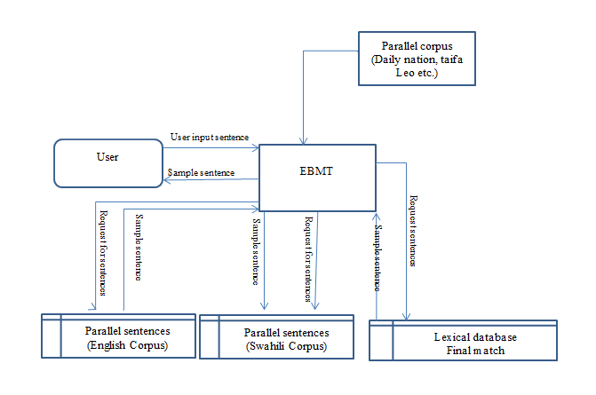
Structure of the EBMT

Slide 9
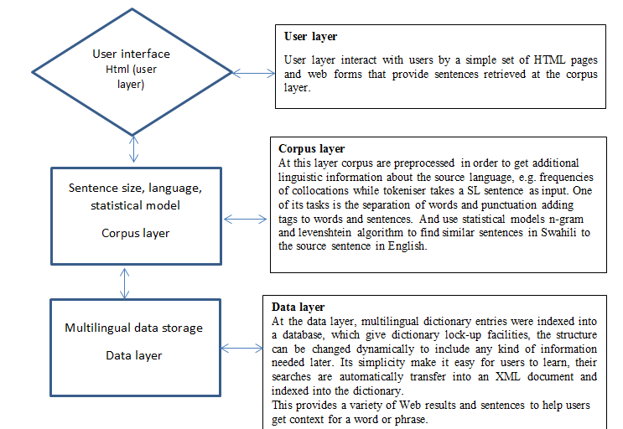
Multilingual Translation Structure

Slide 10
Findings / Results
we conducted our experiment two bilingual corpora both containing translations examples of about 3000 sentence the system was tested in all aspect and also the effect of the topic classifier
In the following aspect
The comprehensiveness of sentence retrieved from multiple resources, conversion to a desired format and integration to the multilingual database.
The accuracy of extracted sentence considering similarity measure
use of classifying text into their domain/topic did show some improvement.

Slide 11
Conclusions
The system developed has demonstrated a promising potential for using sentence similarity in an example-based machine translation
sentence provided better performance
we were able to solve the problem of consistency in translation by using these tool based on translation memories
We also made it possible to reuse old translations stored as translation memories of previous versions of handbooks and thereby reducing the chances of producing variant translations of the same source sentence improving on the quality of the translation memories that are being put to use

Slide 12
Recommendations
From our tool we are able find new sentences in a parallel corpus of comparable html documents, which performed pretty well in terms of precision
To find different techniques for building a new classifier for extracting sentences equivalents from a corpus of comparable html documents.

Slide 13
Areas for further study
text to speech
quality of translations produced
Word ambiguity
Semantic similarity
Structure similarity

Slide 14
End

